Slide 1
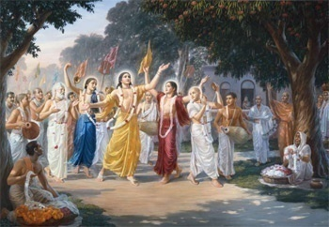
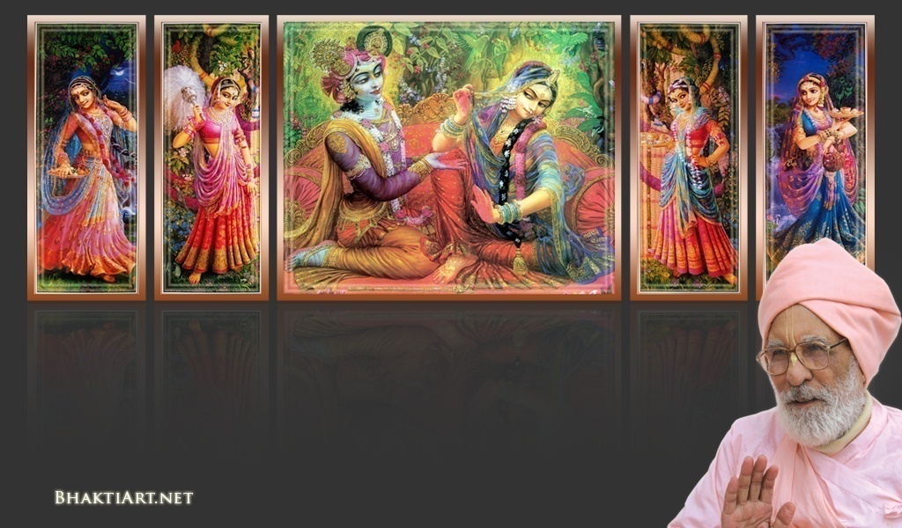
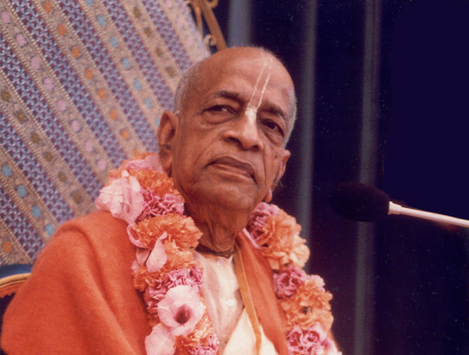
Sri Krsna Caitanya Prabhu Nityananda
Sri Advaita Gadadara Srivasadi
Gaura Bhakta Vrinda
Week 351
Jul 24
2015
Hare Krsna Hare Krsna
Krsna Krsna Hare Hare
Hare Rama Hare Rama
Rama Rama Hare Hare
Gokul Bhajan & Vedic Studies
North Carolina, USA
Notes:
Om Ajnana timirandhasya, jnananjana salakaya
Caksur unmimiltam yena, tasmai sri gurave namah
Namah om vishnu padaya, radhikayah priyatmane
Sri-srimad bhaktivedanta, narayana iti namine
Narayanam gurum vande, Saranam bhakta baandhavam
Gaura manobhishtam poornam, Radha daasyam pradaayakam
Rupaanugaacarya varyam, Rupa manjari preshtakam
Patita paavana baandhava, Yugaacarya naaraayanam
Sri krishna lila kathane sudaksham, Audarya-madhurya gunais ca yuktam
Varam varenyam purusham mahantam, Narayanam tvam sirasa namami
He krishna karuna sindho, dina bandho jagat pate
Gopesha gopika kanta, radha kanta namo ‘stu te
Tapta kancana gaurangi, radhe vrindavaneshvari
vrsabhanu sute devi, pranamami hari priye
bhajami radham aravinda netram, smarami radham madhurasmi-tasyam
vadami radham karuna bharardram, tato mam anyasti gatir na kapi
bhaktya vihina aparadha-laksaih, ksiptas ca kamadi-taranga-madhye krpamayi tvam saranam prapanna, vrnde namas te caranaravindam
--------------------------
First of all, I pay my koti dandavat pranams to my diksha guru Om vishnupada rupanuga acharya Sri Sri Bhakti Vedanta Narayana Goswami maharaja. My koti dandavat pranams to Sri Sri Bhakti Vedanta Swami Prabhupada, and guru varga.
My humble pranams at the lotus feet of all assembled devotees, vaishnavas and vaishnavis..

Slide 2
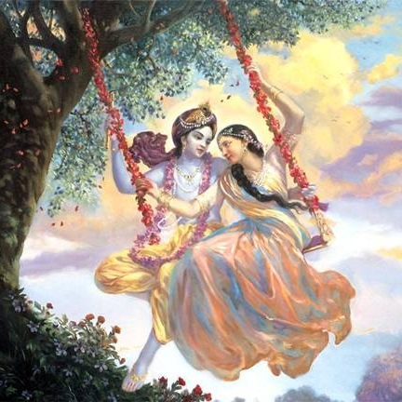
Jaya Rādha Mādhava
Jaya Kunja Vihārī
Jaya Gopī Jana Vallabha
Jaya Giri Vara Dhārī ... (Jaya)
Yaśodā Nandana Vraja Jana Ranjana
Yamunā tīra Vana Cāri ... (Jaya)
[ Hare Krishna Hare Krishna
Krishna Krishna Hare Hare
Hare Rāma Hare Rāma
Rāma Rāma Hare Hare ]

Slide 3
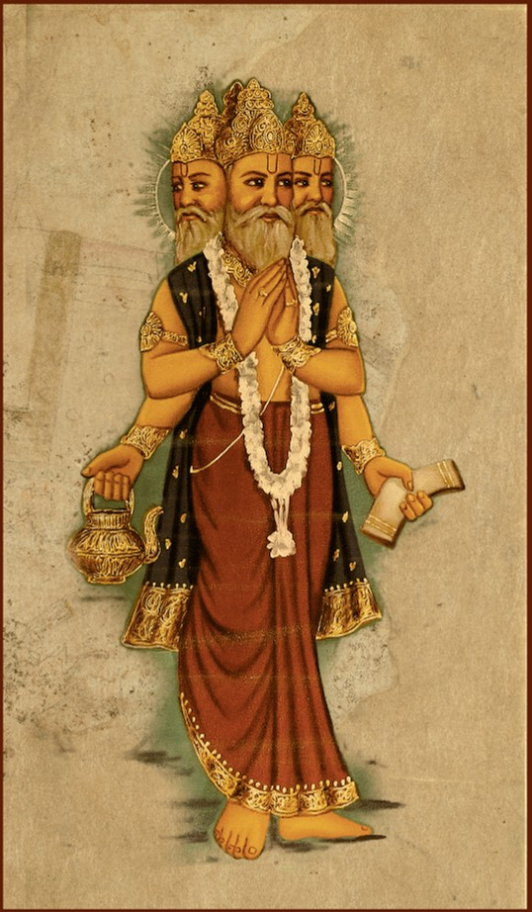
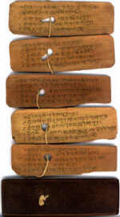
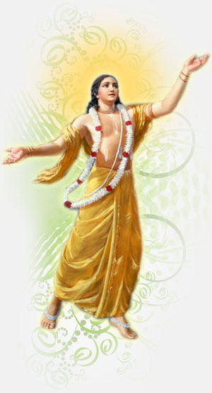
Slides Video
Brahma Samhita

Slide 4
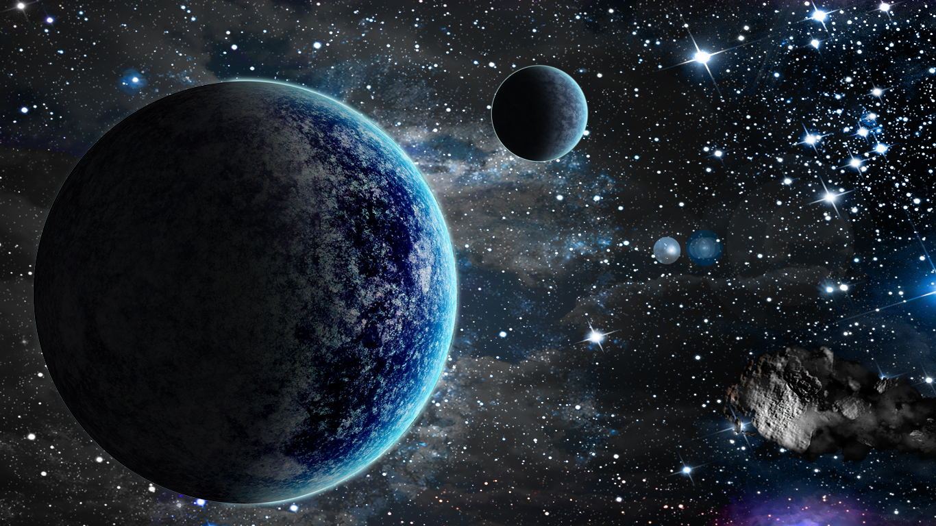
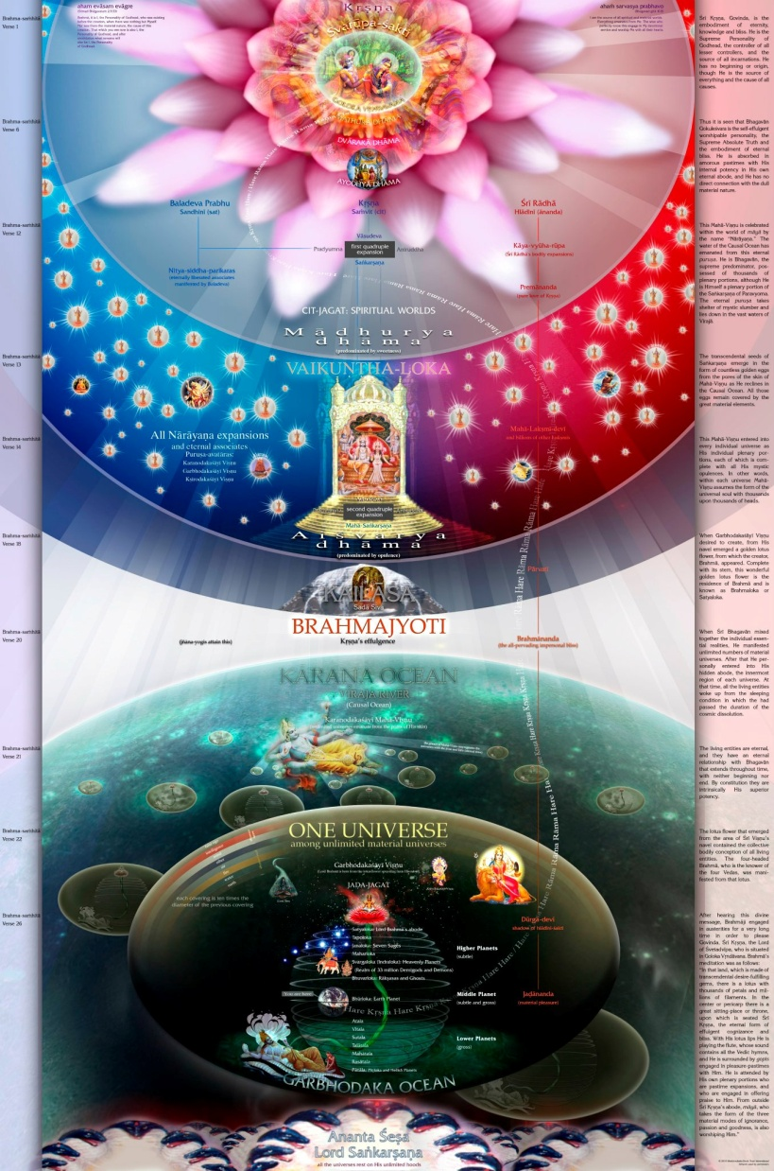
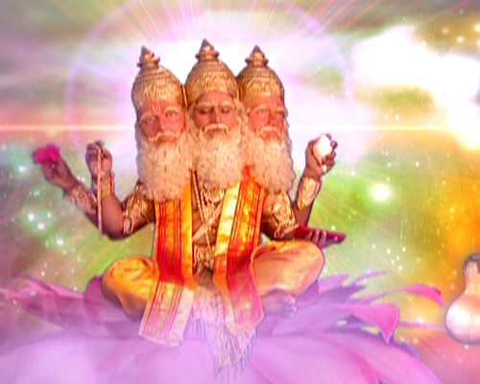
Sri Brahma Samhita: Verse-30

Slide 5
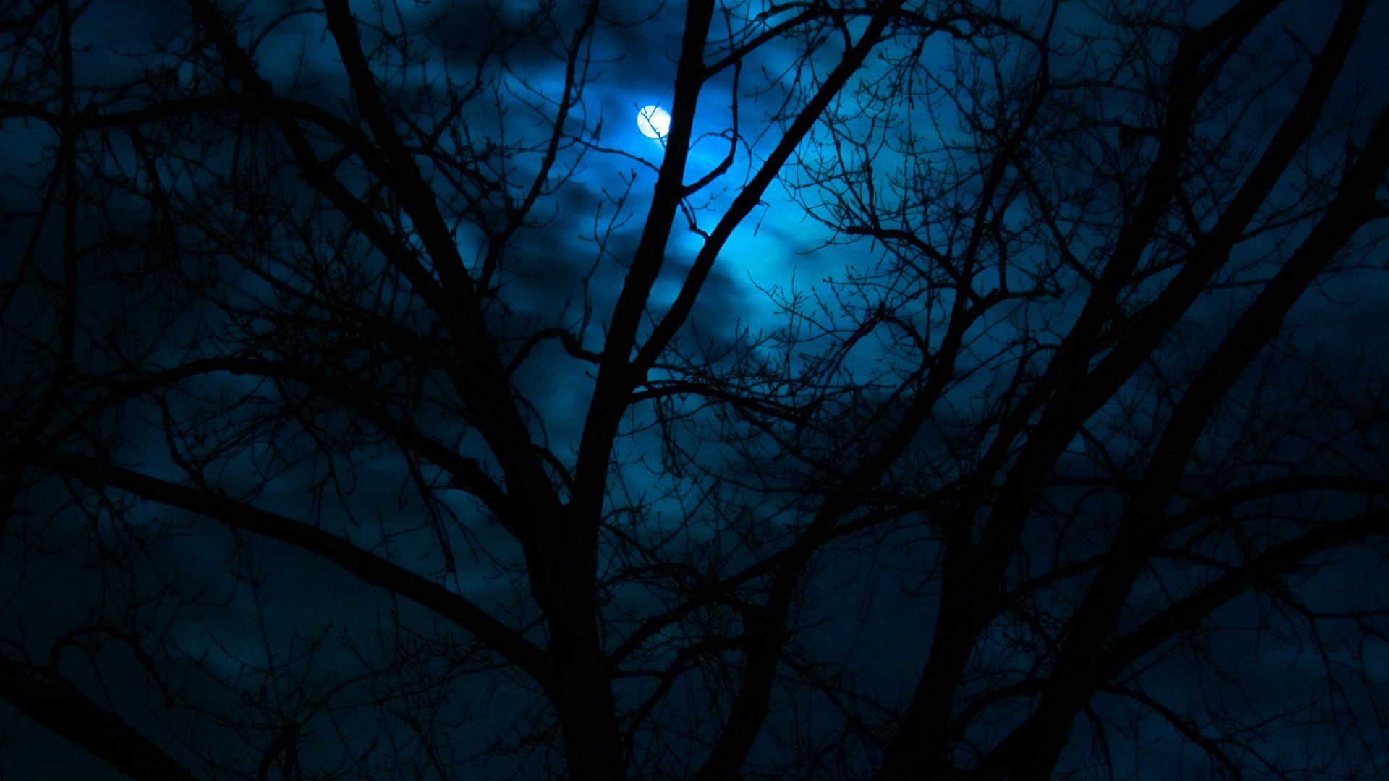
BS - 30
veṇuḿ kvaṇantam aravinda-dalāyatākṣam-
barhāvataḿsam asitāmbuda-sundarāńgam
kandarpa-koṭi-kamanīya-viśeṣa-śobhaḿ
govindam ādi-puruṣaḿ tam ahaḿ bhajāmi
I worship Govinda, the primeval Lord, who is adept in playing on His flute, with blooming eyes like lotus petals with head decked with peacock's feather, with the figure of beauty tinged with the hue of blue clouds, and His unique loveliness charming millions of Cupids.

Slide 6
veṇuḿ - the flute
kvaṇantam - playing
aravinda - lotus
dala - petals
āyata - blooming, stretching
akṣam - whose eyes
barha – peacock feather
avataḿsam - ornament on head
asita - not white (blue black)
ambuda - cloud
sundara - beautiful
ańgam – figure or form
Notes:
Parama Isvara – Topmost controller
Anaadi – No source of birth
Shiva – Maheshwara - mahaancha asa ishwara
Svetas
Katopanishad: Nityo Nityaanaam, Cetano Cetanaam
Eko bahunaam ved
Krishi Bhu

Slide 7
Kandarpa - Cupids
Koṭi - millions
Kamanīya - charming
Viśeṣa - unique
Śobhaḿ - loveliness
govindam - Lord Krsna
ādi - original
puruṣaḿ - person
tam - Him
ahaḿ - I
bhajāmi - worship
Notes:
Parama Isvara – Topmost controller
Anaadi – No source of birth
Shiva – Maheshwara - mahaancha asa ishwara
Svetas
Katopanishad: Nityo Nityaanaam, Cetano Cetanaam
Eko bahunaam ved
Krishi Bhu

Slide 8
veṇuḿ kvaṇantam
Notes:
We learned that Lord Brahma heard a flute sound?
From whom do you think it is from?
Yes, from Krishna.
First the sound ‘TA PA’ came.. TAPA, TAPA, TAPA.
Krishna within the heart of Brahma instructed Him to meditate.
So, Brahma was meditating for a long time..
Then Krishna’s flute sound came again!.
He gave the GOPALA MANTRA thru SARASVATI
The He gave the KAMA GAYATRI.
Then by the flute, Krishna then gave the whole knowledge of creation to Lord Brahma.
But can one easily hear HIS flute sound?

Slide 9
Notes:
Surely the pure devotees of Krishna can hear HIS flute...
Can a Yogi hear this?
NO..
What does a Yogi hear when they mediatate very sincerely for thousand of their life time?

Slide 10
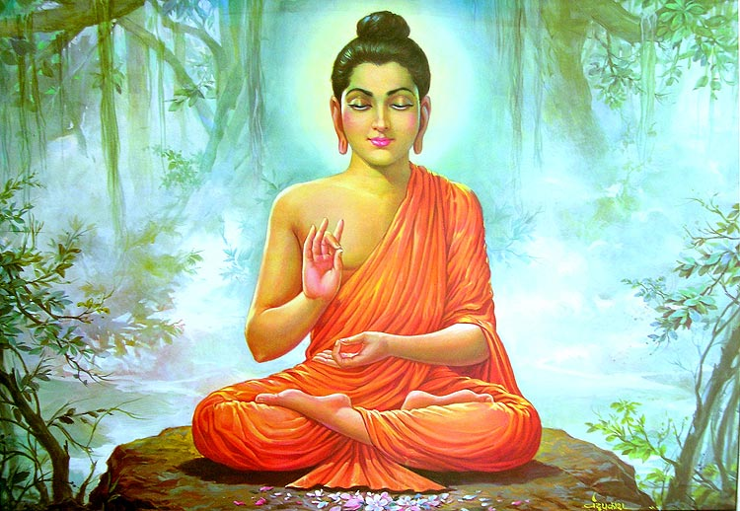
What do yogis hear in stages of their meditation?
Notes:
Our scriptures say many secret truths about God Realization..
When Yogies meditate, they are actually cheated because of their lack of BHAKTI..
How..

Slide 11
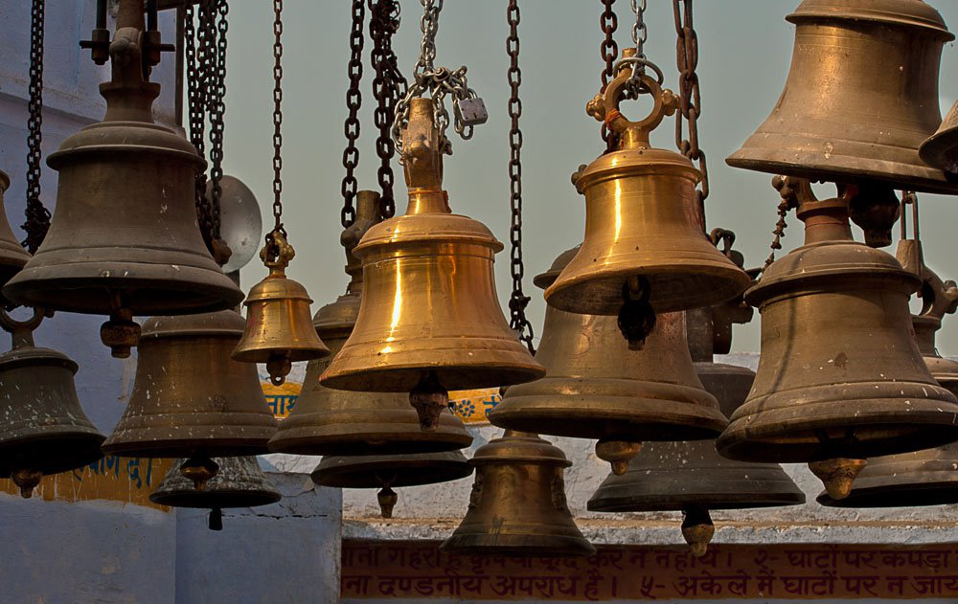
(1)
Notes:
When a yogi progresses, he/she hears ringing bell..
Yoga Upanishad...
Starts with CHINI.. CHINI..
Spiritual bells... (Note that we do it first in the temple worship!)

Slide 12
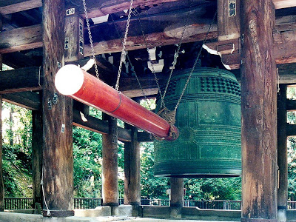
Notes:
In some countries like Tibet and Japan, they do the ringing of bells in a grand way and so loud so that every one can hear..
‘

Slide 13
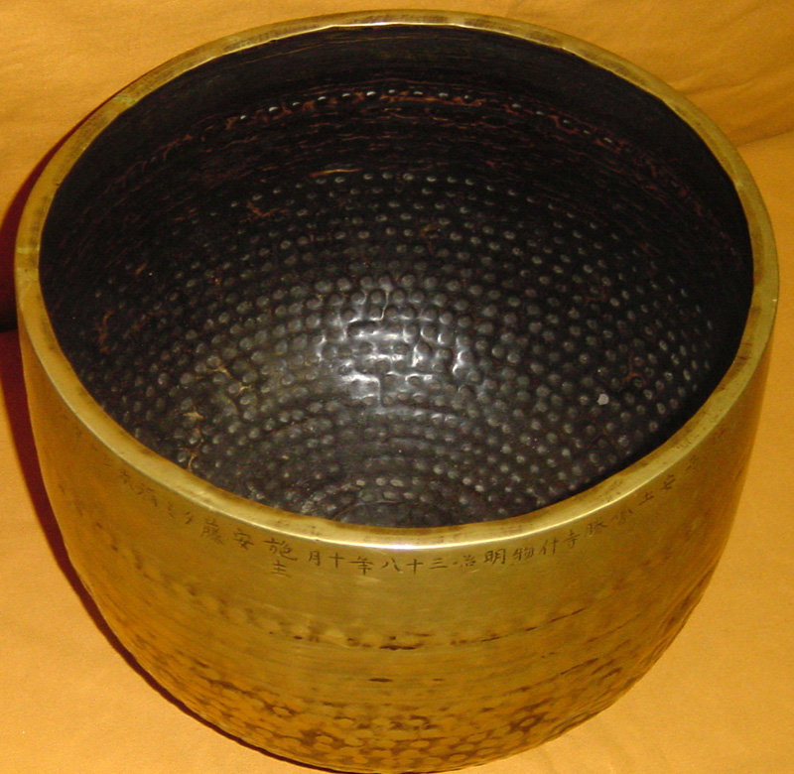
Notes:
Have you heard about this special bowl?
It makes a nice sound for meditation!

Slide 14
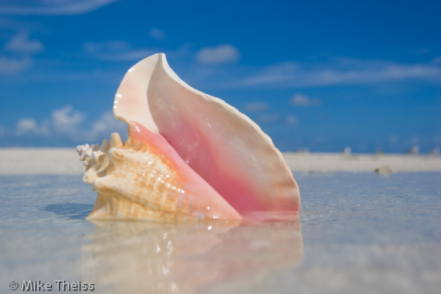
(2)
Notes:
Then the Yogi hears the sound of CONCH SHELL...
It is so amazing sound and they want to hear again and again.
Most of the Yogis declare that they have heard from God..

Slide 15
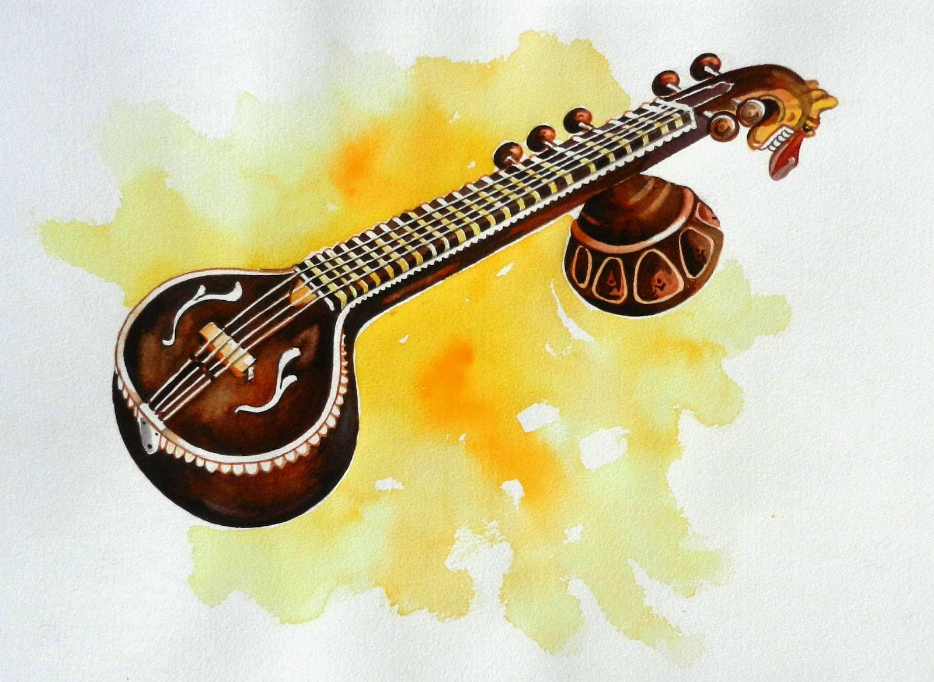
(4)

Slide 16
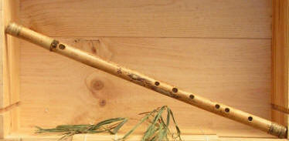
(5)
(7)
Notes:
Then flute...
Whose flute is this?
This is not the flute of Krishna!
Here the Yogis are tricked!!!!
Only HIS PURE DEVOTEES can hear Krishna’s flute!!

Slide 17
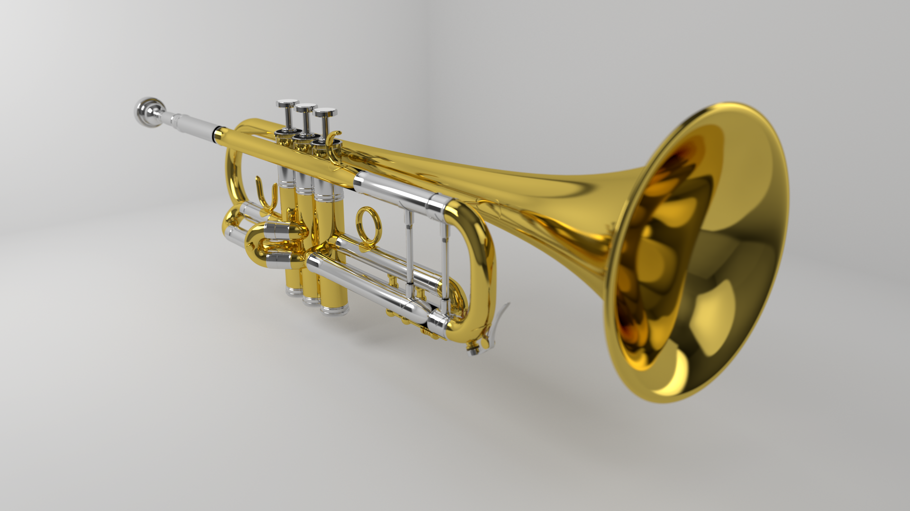
(6)
Notes:
Triumpet...

Slide 18
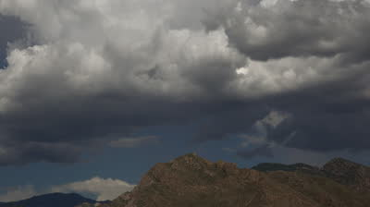
(3)
(7)
Notes:
Rumbling of Clouds...
Then, all the sounds simply die..
What is the EIGHT??? Now, the Yogi has received Ashta Siddhi..
And the Yogis declare that he is the GOD..

Slide 19
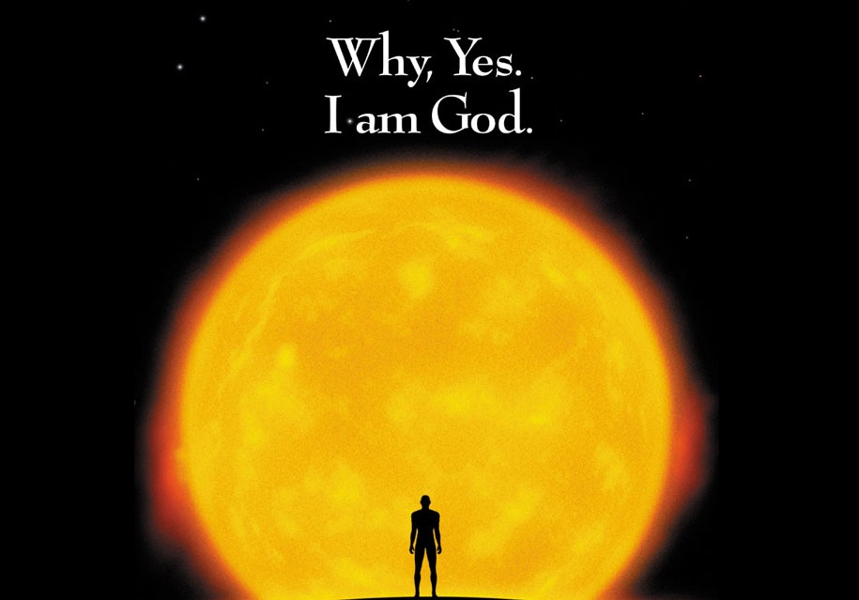
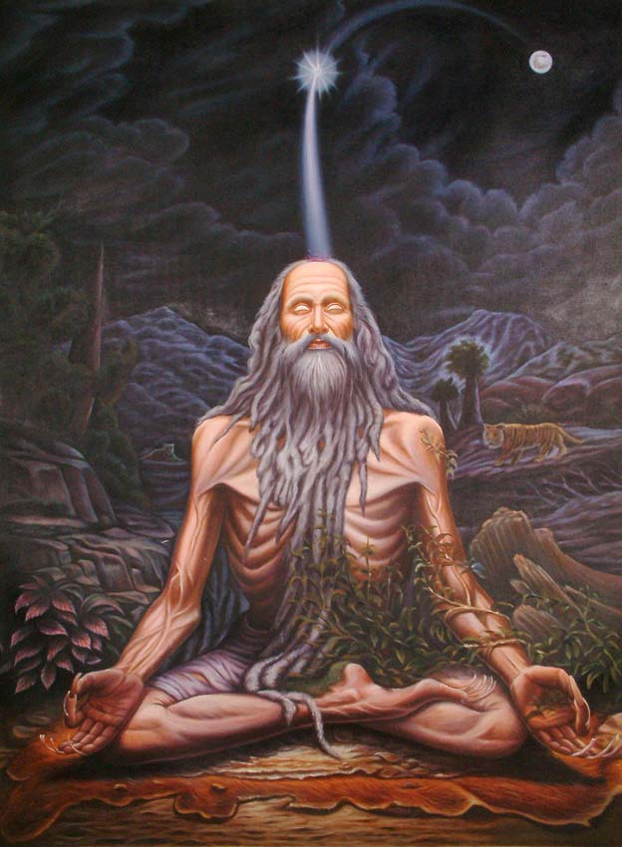

Slide 20
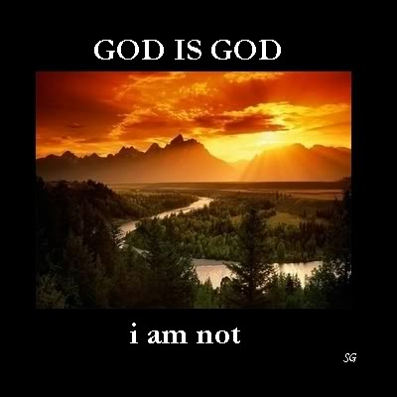

Slide 21
To reach Krishna, there is only one path you should take
– Path of Bhakti..

Slide 22
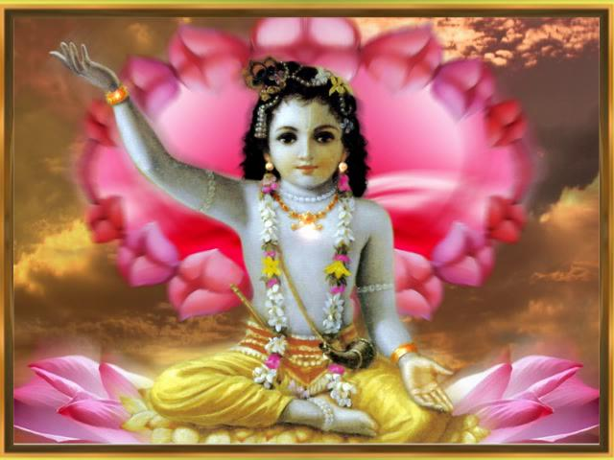
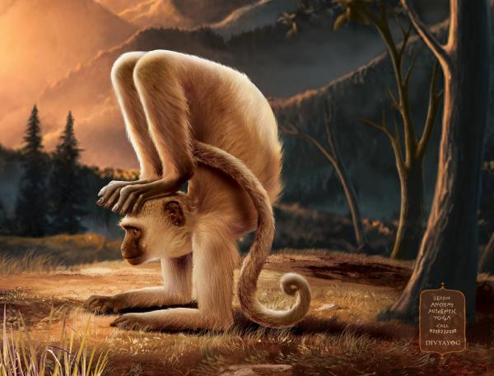
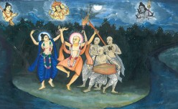
Which path will you take?
Notes:
Monkey Yogi path
Or
Pure Bhakti Path?

Slide 23
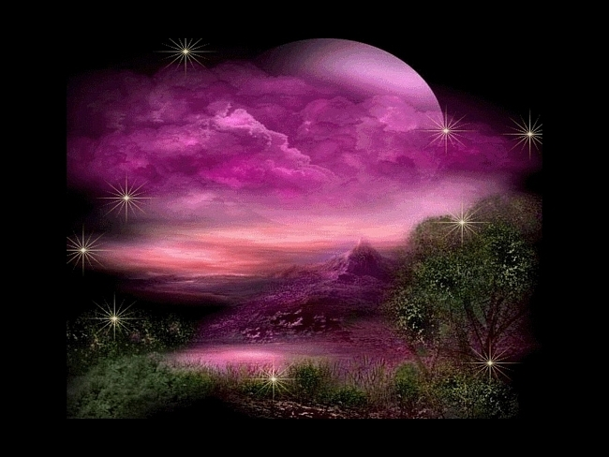
veṇuḿ kvaṇantam
What happens when Krishna plays on His flute?
Notes:
Venu – flute
Kvantam – making sound
(playing flute)
What does the scripture say when Krishna plays His flute?

Slide 24
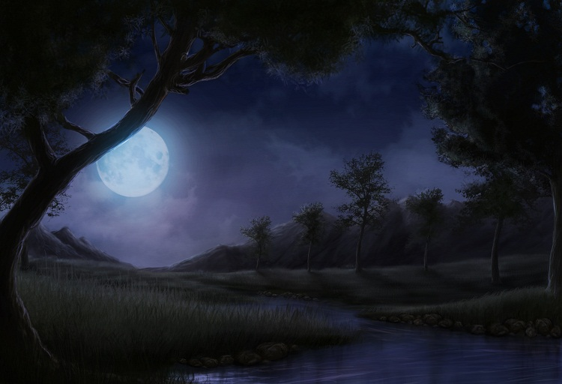
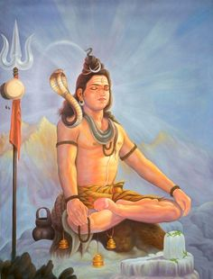
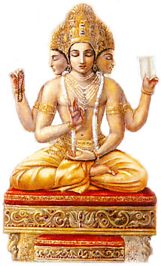
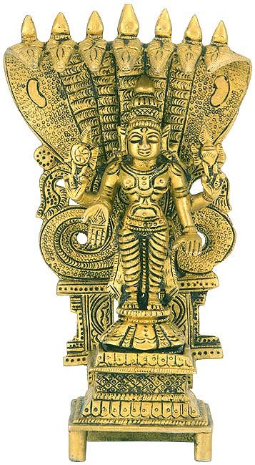
Tune-1:
Makes Lord Brahma and Lord Siva's meditation is broken and they forget everything in astonishment and Lord Anantadeva sways His head like in hypnosis.

Slide 25
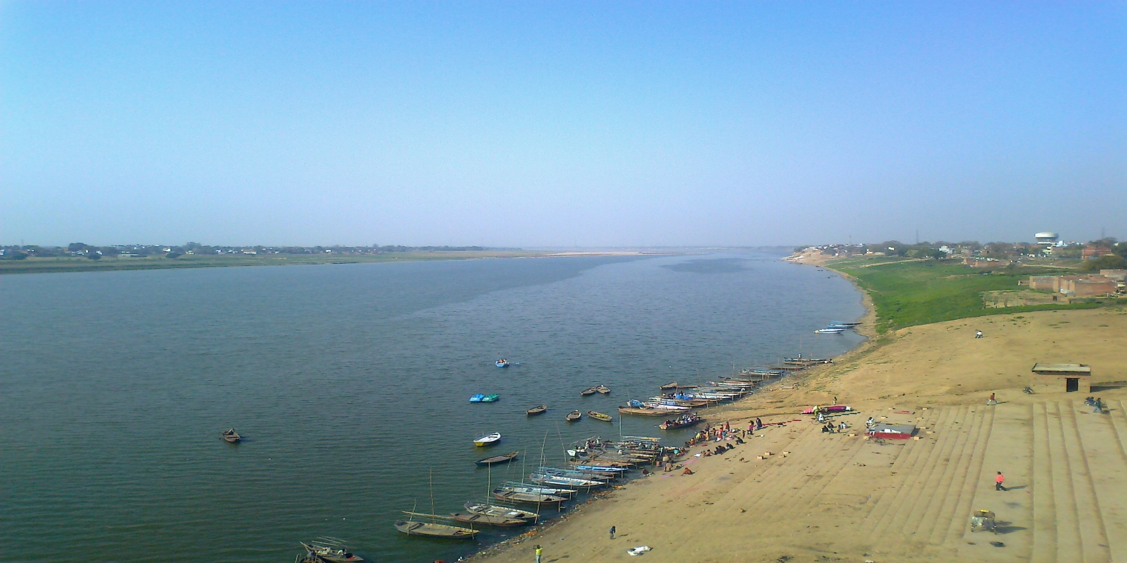
Tune-2:
Makes Yamuna to flow backwards

Slide 26
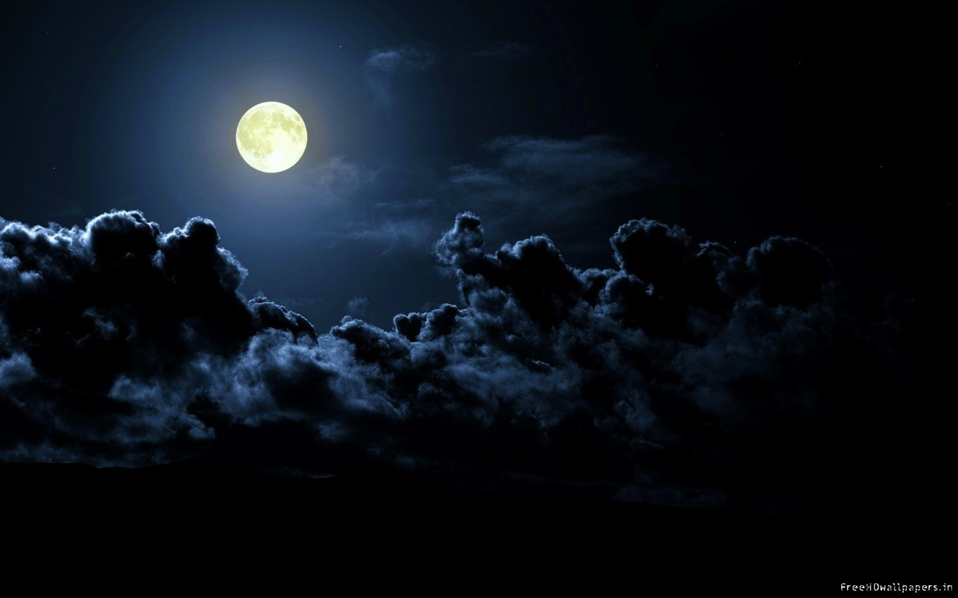
Tune-3:
Makes the moon stops moving...

Slide 27
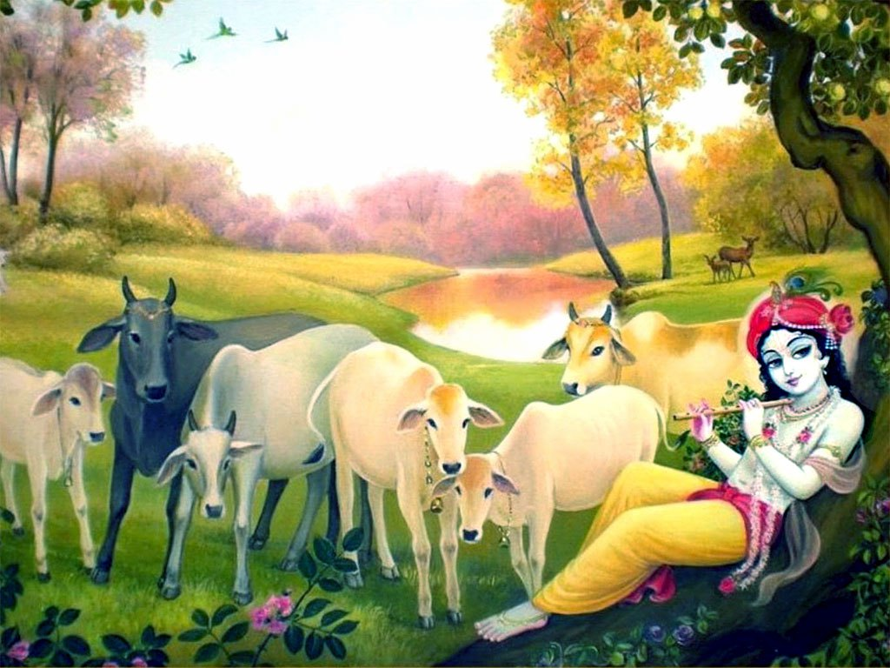
Tune-4:
Makes the cows to run to Him in ecstacy, forgetting everything...
Notes:
Cows forgets to swallow the grass...
Calves forget to drink the milk, and flows thru the sides of their mouths..

Slide 28
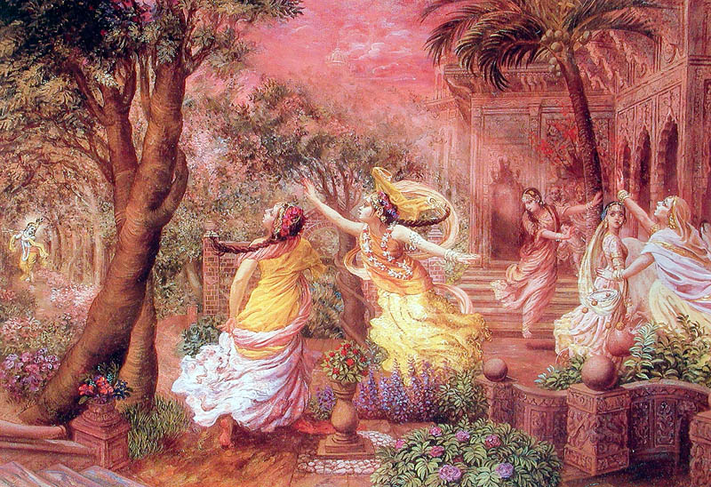
Tune-5:
Makes the gopis come running to Him...

Slide 29
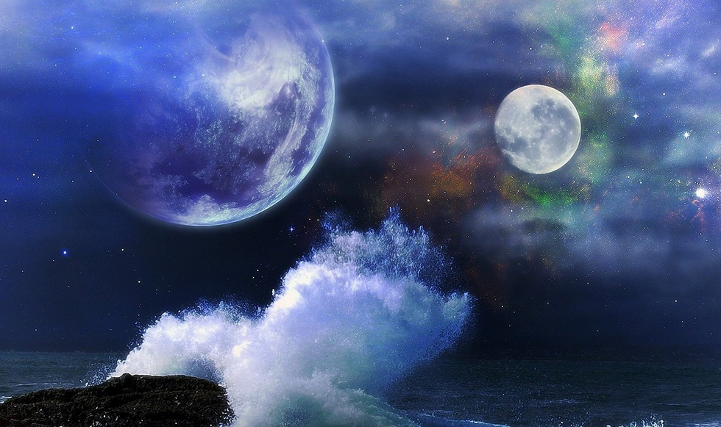
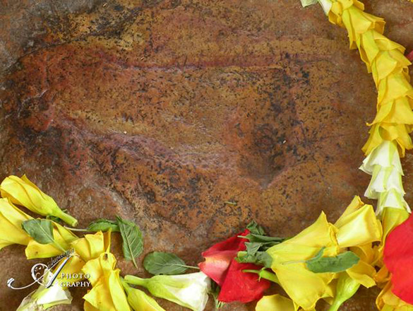
Tune-6:
Stones to melt and manifests autumn season..

Slide 30
Tune-7:
Makes all the seasons to manifest same time!

Slide 31
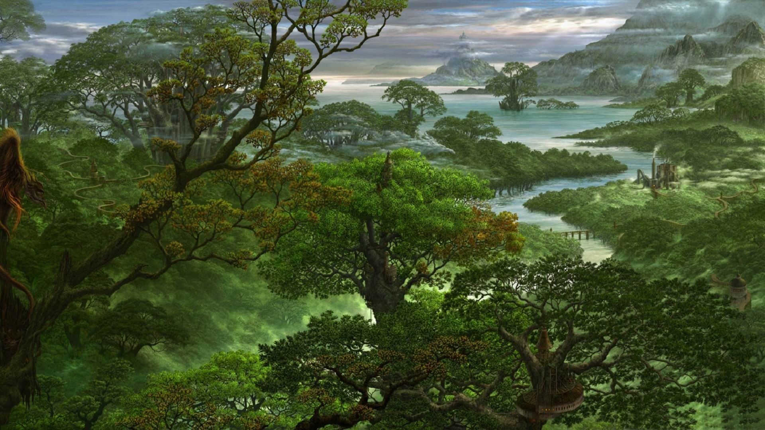
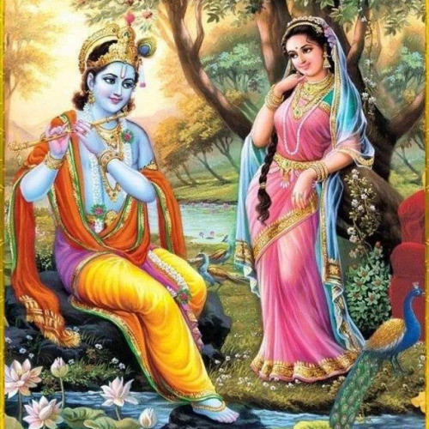
Tune-8:
Exclusively for Radha Rani only...
Notes:
8th Note is meant exclusively for Srimati Radharani,
it takes Her name and calls for Her, and She comes running to Him putting Her cloth wrong and mascara also.

Slide 32
aravinda-dalāyatākṣam
Notes:
Aravinda – Lotus
Dala – petal
Aayata – blooming (Stretching from Wider to Narrow)
aksham – whose eyes

Slide 33
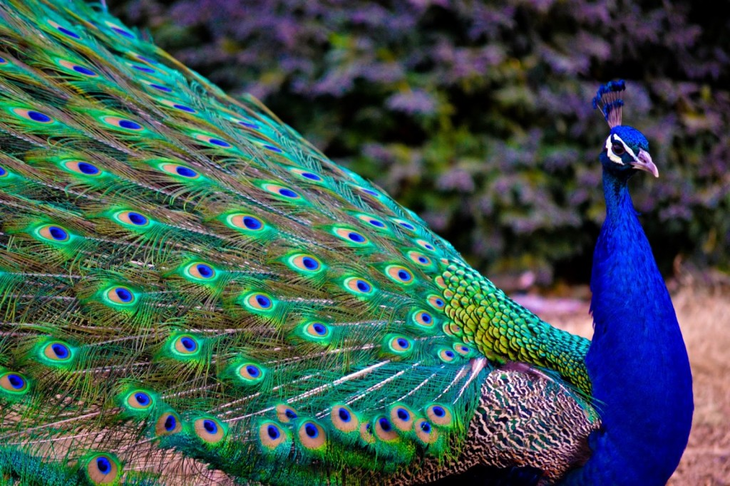
barhāvataḿsam
Notes:
Barha – Peacock feather
Avatamsam – crest (head)

Slide 34
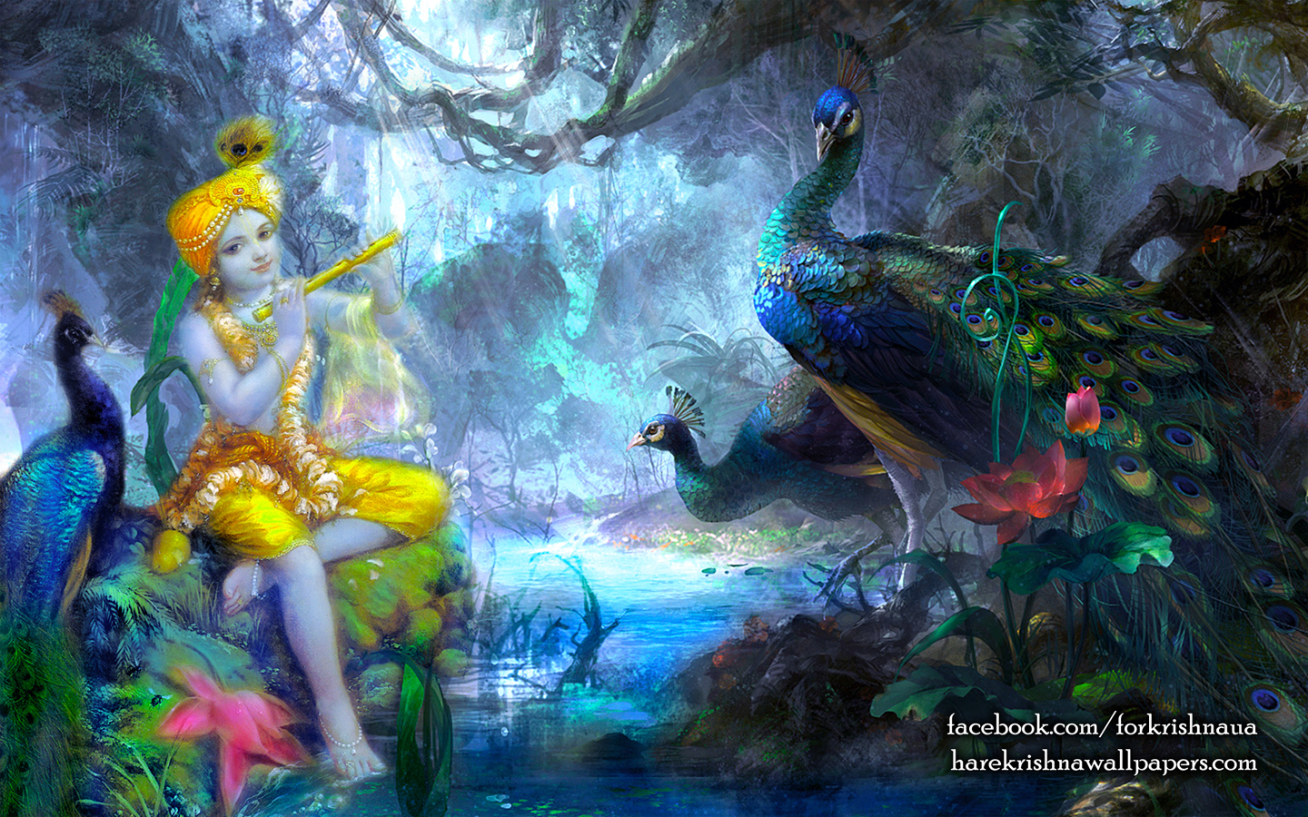
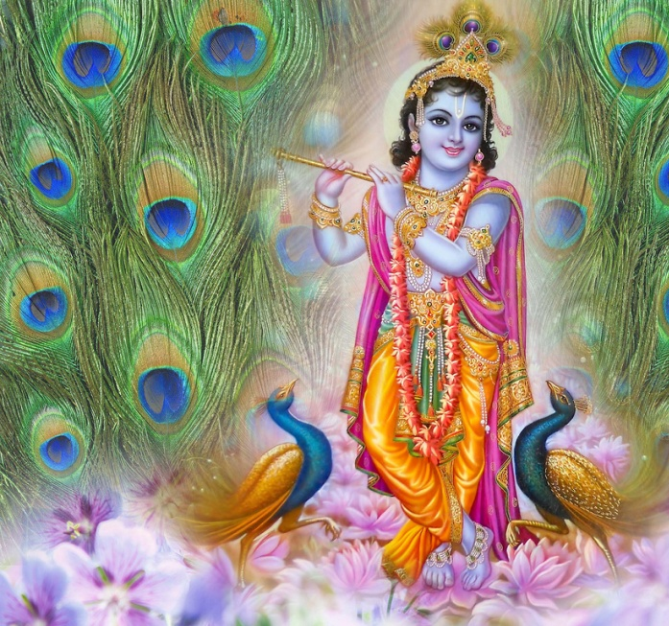

Slide 35
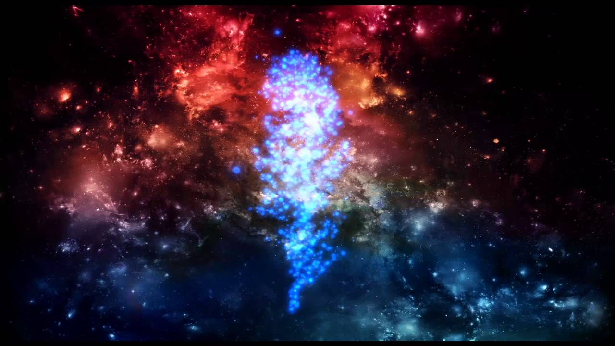

Slide 36
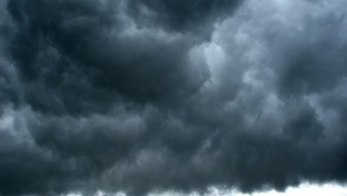
asitāmbuda...
Notes:
Sita – white
Asita – Not white – black or dark – and tinged
Ambuda – Ambu dadaati iti Ambuda – rain cloud
How can the black be beautiful?

Slide 37
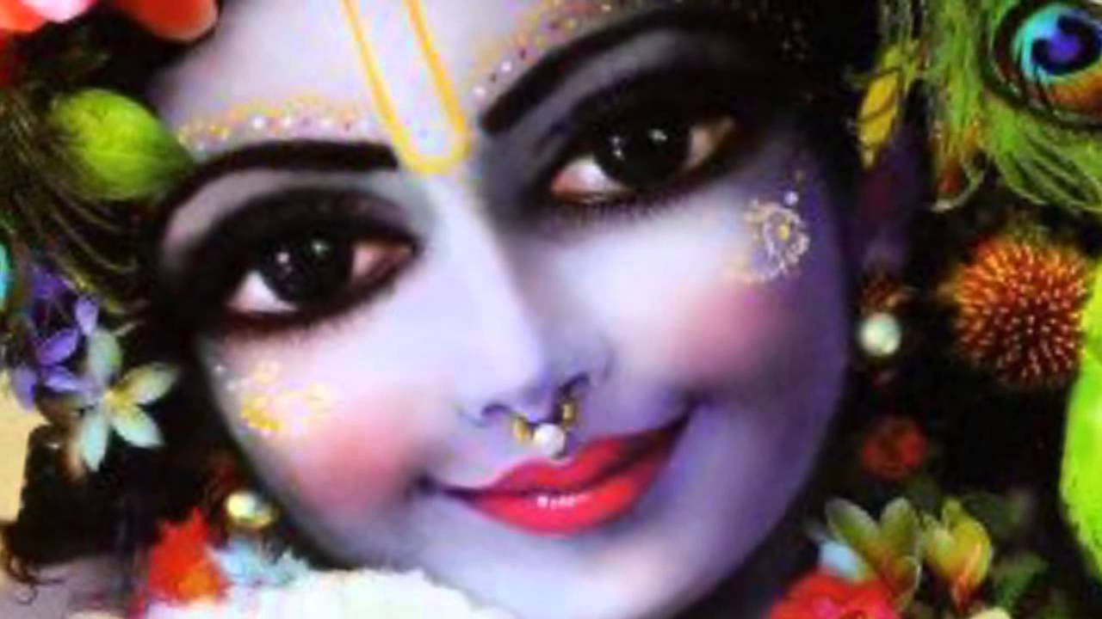
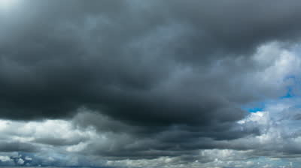
...sundarāńgam
Notes:
He is SUNDARA ANGAM..
He has the spiritual darkish color – the most beautiful!
He has the most beautiful angas - limbs

Slide 38
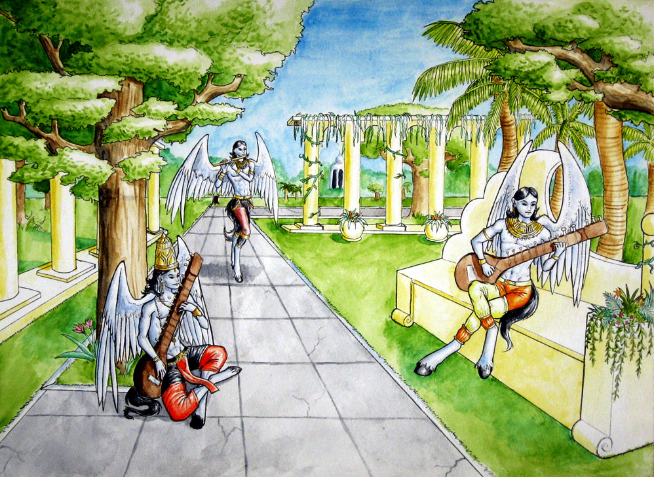
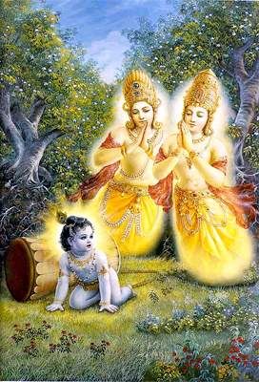
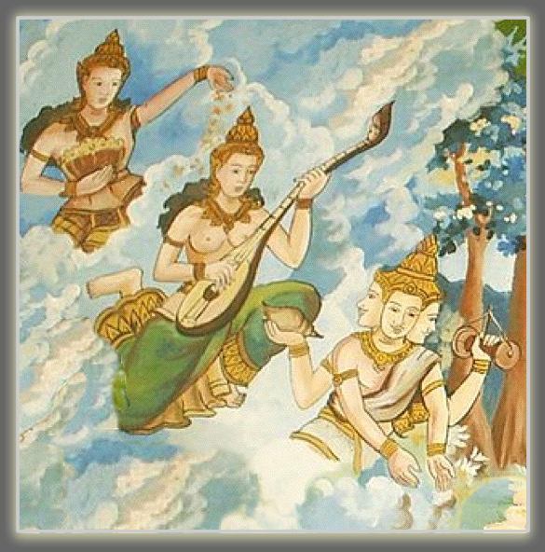
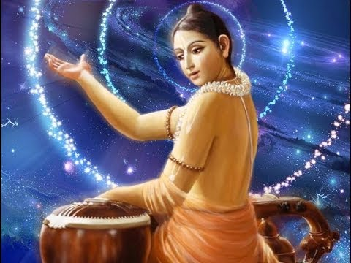
kandarpa-koṭi-kamanīya...
Notes:
Kandarpa -> Cupids
They are also called Gandarvas.. They are the most beautiful.. Most importantly they sing very nicely..
Gandarva loka – full of music and singing...
It is a loka (dimension) of Music..
Singing of what?
Not the POP and ROCK and RAP...!!
But to glorify Gods!
All the classical musics – originates from this Loka!
There are many saints too living here..
We know 2 Gandarvas who were cursed by Narada and later delivered by Krishna..
Manigriva and Nalakuvera
And a very famous devotee who belong to this place..
NARADA!
If one sings POP or ROCK -> next birth will be born as DONKEY!

Slide 39
D-39
swaagatam krishnaa saranaagatam krishnaa
madhuraapuri sadanaa mridu vadanaa madhusoodana iha
Boga Thaptha sulabha supushpa gandha kalapa,
Kasthuri thilaka mahitha mama kantha nanda gopa Kandha
Mushtikasura Chanoora malla ,
Madhu soodhana , Kuvalayapeeda,
Mardhana, Kalinga narthana ,
Gokula Rakshana , Sakala sulakshana,
Deva sishta jana pala , Sankalpa kalpa ,
kalpa satha koti samprabhava,
Dheera , Muni jana vihara . Madana sukumara ,
Daithya samhara, deva,
Madhura madhura rathi sahasa ,
sahasa Vruja yuvathi jana manasa poojitha.
Main Index
Series Index
Notes:
Ragam – Mohanam
Composer: oothukaadu venkata Subbhaiar – a famous saint in South India

Slide 40
kamanīya-viśeṣa-śobhaḿ...
Notes:
He excels the beauty of millions of Cupids..
Kamaniya – Very Charming
Visesha – Special
Sobham – Loveliness
SIDE GLANCE is the MOST SPECIAL – very Beautiful – Every one gets attracted!!

Slide 41
Sri Brahma Samhita: Verse-31

Slide 42
BS - 31
ālola-candraka-lasad-vanamālya-vaḿśī-
ratnāńgadaḿ praṇaya-keli-kalā-vilāsam
śyāmaḿ tri-bhańga-lalitaḿ niyata-prakāśaḿ
govindam ādi-puruṣaḿ tam ahaḿ bhajāmi
I worship Govinda, the primeval Lord, round whose neck is swinging a garland of flowers beautified with the moon-locket, whose two hands are adorned with the flute and jeweled ornaments, who always revels in pastimes of love, whose graceful threefold-bending form of Syamasundara is eternally manifest.

Slide 43
ālola - swinging
candraka- with moon locket
lasad - beautified
vanamālya- garland of flowers
vaḿśī - flute
ratna –jewel
ańgadaḿ - adorned with
praṇaya - of love
keli-kalā - pastimes
vilāsam – who always performs

Slide 44
Śyāmaḿ - Syamasundara
tri-bhańga - bent in 3 places
lalitaḿ - graceful
niyata - eternally
prakāśaḿ - manifest
govindam - Lord Govinda (Krsna)
ādi - original
puruṣaḿ - person
tam - Him
ahaḿ - I
bhajāmi - worship

Slide 45
ālola-candraka-lasad-vanamālya-vaḿśī-
Notes:
ālola - swinging --- ( dangling to and fro )
Candraka - with moon locket
lasad - beautified
Vanamālya - garland of flowers
vaḿśī - flute

Slide 46
ratnāńgadaḿ
Notes:
ratna –jewel
ańgadaḿ - adorned with

Slide 47
praṇaya-keli-kalā-vilāsam
Notes:
praṇaya - of love
keli-kalā - Sportive pastimes
vilāsam – who ALWAYS performs
Krishna is never Lazy.. Always Active... Keli Kalaa Vilaasam
Who told you that te nature of Jivas to become nothing – no action, nothing!
They are cheated..
Those who merge in Brahman are making Spiritual Suicide – Killing their own souls..
So, WAKE UP! Do work for Krishna!

Slide 48
śyāmaḿ tri-bhańga-lalitaḿ
Notes:
Śyāmaḿ - Syamasundara
tri-bhańga - bent in 3 places -- NECK, HIP and LEG
lalitaḿ - graceful
TRIBHANGA is the most Beautiful form of Krishna – Only NANDA Nandana Krishna!

Slide 49
niyata-prakāśaḿ
Notes:
niyata - eternally
prakāśaḿ - manifest
In His world, called Goloka, he is eternally manifested..
In Goloka,
There is no worry
No one to bother you No homework, No music practice, no school!
Always in bliss
And whatever you want, you get from the Kalpa-Vriksha!!

Slide 50
Premadam ca me kaamadam ca me
Vedanam ca me (Krishna) vaibhavam ca me
Jeevanam ca me jeevitam ca me
Daivatam ca me (Krishna) deva na 'param ... (Prema)
Nanda Nandanam Nalina Sundaram
Naatya Shobhanam (Krishna) Nava Vichaaranam
Murali Gaananam Madhura Bhaavanam
Nayana Lochanam (Krishna) Naada Bheejanam ... (Prema)
Padma Naabhanam Prema Kaantanam
Parama Chetanam (Krishna) Bhakta Bhoshanam
Bandha Chedanam (Krishna) Purushottamam
Bhuvana Rakshakam Pari Paalanam ... (Prema)
Manda Haasanam Madana Mohanam
Maaya Leelanam (Krishna) Madhu Sudhanam
Meha Varnanam Man-Manoharam
Moola Taaranam (Krishna) Mantra Rupakam ... (Prema)
Krishna Govindam Geetai Naayakam
Gokul Jeevanam (Krishna) Gopya Saakhyatam
Raaja Leelanam Ramya Kelanam
Radhe Maadhavam (Krishna) Rasika Baalanam ... (Prema)
E-94

Slide 51
Which Krishna primarily worshipped by Gaudiya Vaishnavas?
None of these!
Bala
Krishna
Giridhara
Gopala
Krishna
Vasudeva
Krishna
Dwaraka
Krishna
Yogiswara
Krishna
Notes:
Bala Krishna – Vallbacharya – Pushti Marg
Giridhara Gopala – Meera Bai
Vasudeva Krishna – Those who want Vaikuntha – or Mukti and possess forms of the Lord
Dwaraka Krishna – To live in opulence in the spiritual Dwaraka
Yogiswara Krishna – Those who want to get power and mystics and fooled themselves to be God.
What does Krishna say? – I am not in the heart of yogis!

Slide 52
śyāmaḿ tri-bhańga-lalitaḿ
Notes:
Who is this one?
Nanda Nandan Krishna! The one with 3 bending form..
That is only Nanda Nandan Krishnan – Not Bala Krishna, Not Gopala Krishna, No Vasudeva Krishna, Not Dwaraka Krishna
And definitely not the Yogiswara Krishna!!!
What is so special about Syamam Tribhangam – the Nanda Nandana Krishna
Because He is with Srimati Radha Rani!!!
In vrindavan, they all say “RADHEY RADHEY....” – not Krishna Krishna!

Slide 53
Notes:
Why?
What is the MAIN KEY in worshipping which form of Krishna?
How do you decide?
Very Simple – Is Radha Rani in it?

Slide 54
ratim- gaurī-līle api, tapati saundarya-kiraṇaiḥ
śacī-lakṣmī-satyāḥ pari-,bhavati saubhāgya-balanaiḥ
vaśī-kārais’ candrāvalī-,mukha-navīna-vraja-satīḥ
kṣipaty ārād yā tam- hari-,dayita-rādhām- bhaja manaḥ
- Manh Siksha Text 10 (by Sri Raghunatha Dasa Goswami)
O mind, please worship Lord Hari’s beloved Radha. With the splendor of Her beauty She makes Rati, Gauri, and Lila burn with envy, with the power of Her good fortune She defeats Shaci, Lakshmi, and Satyabhama, and with Her ability to control Krishna She completely eclipses Candravali and the other pious young girls of Vraja.

Slide 55
F-05
O Radhe Jaya Radhe
Mahaa Raani Subha Radhe
Madan Mohana Priya Radhe
Jagan Mohini Sri Radhe
Vrindaavana Jana Radhe
Vrshabhanu-su Sutaa Radhe ... (O Radhe)
Paramdhaamana Prema Radhe
Para Sakhi Gana Priya Radhe
Rasa Leelana Vraja Radhe
Ramya Bhajamana Daya Radhe ... (O Radhe)

Slide 56
Slides Video
Brahma Samhita

Slide 57
QUESTIONS?
Notes:
veṇuḿ - the flute
kvaṇantam - playing
aravinda - lotus
dala - petals
āyata - blooming
akṣam - whose eyes
barha – peacock feather
avataḿsam - ornament on head
asita - not white (blue black)
ambuda - cloud
sundara - beautiful
ańgam – figure or form
Śyāmaḿ - Syamasundara
tri-bhańga - bent in 3 places
lalitaḿ - graceful
niyata - eternally
prakāśaḿ - manifest
------------------------------------
ālola - swinging
Candraka - with moon locket
lasad - beautified
Vanamālya - garland of flowers
vaḿśī - flute
ratna –jewel
ańgadaḿ - adorned with
praṇaya - of love
keli-kalā - pastimes
vilāsam – who always performs
Śyāmaḿ - Syamasundara
tri-bhańga - bent in 3 places
lalitaḿ - graceful
niyata - eternally
prakāśaḿ - manifest

Slide 58
Thus ends...
Brahma Samhita – 02 (Verses 30, 31)

